Slide 1
Dynamic Programming
Course Code: CSC 2211
Course Title: Algorithms
Dept. of Computer Science
Faculty of Science and Technology
Lecturer No: | F01 | Week No: | 08 | Semester: | Summer 2022-2023
Lecturer: | Md. Mustak Un Nobi, ( mustak.nobi@aiub.edu )

Slide 2
Lecture Outline
Introduction to Dynamic Programming
Elements of Dynamic Programming
Designing a Dynamic Programming Algorithm
0/1 Knapsack Problem

Slide 3
Fibonacci Numbers
Leonardo Fibonacci (1202):
  A rabbit starts producing offspring during the second year after its birth and produces one child each generation
  How many rabbits will there be after n generations?
F(3)=1
F(3)=2
F(1)=1
F(2)=1
+1
F(4)=2
F(5)=3
+2
F(6)=5
+3
F(4)=3
+1
F(5)=5
F(6)=8

Slide 4
…Fibonacci Numbers
F(n)= F(n-1)+ F(n-2)
F(0) =0, F(1) =1
  0, 1, 1, 2, 3, 5, 8, 13, 21, 34 …
Straightforward recursive procedure is slow!
FibonacciR(n)
01 if n ≤ 1 then return n
02 else return FibonacciR(n-1) + FibonacciR(n-2)

Slide 5
…Fibonacci Numbers
F(6) = 8
F(5)
F(4)
F(4)
F(3)
F(3)
F(2)
F(3)
F(2)
F(2)
F(1)
F(2)
F(1)
F(1)
F(0)
F(2)
F(1)
F(1)
F(0)
F(1)
F(0)
F(1)
F(0)
F(1)
F(0)
We keep calculating the same value over and over!
  Subproblems are overlapping – they share sub-subproblems

Slide 6
…Fibonacci Numbers
How many summations are there in F(n)?
  F(n) = F(n – 1) + F(n – 2) + 1
  F(n) ≥ 2F(n – 2) +1 and F(1) = F(0) = 0
  Solving the recurrence we get
  F(n) ≥ 2^{n/2} – 1 ≈ 1.4^{n}
Running time is exponential!

Slide 7
…Fibonacci Numbers
We can calculate F(n) in linear time by remembering solutions to the solved sub-problems (= dynamic programming).
Compute solution in a bottom-up fashion
Trade space for time!
Fibonacci(n)
01 F[0]←0
02 F[1]←1
03 for i ← 2 to n do
04 F[i] ← F[i-1] + F[i-2]
05 return F[n]

Slide 8
…Fibonacci Numbers
In fact, only two values need to be remembered at any time!
FibonacciImproved(n)
01 if n ≤ 1 then return n
02 Fim2 ←0
03 Fim1 ←1
04 for i ← 2 to n do
05 Fi ← Fim1 + Fim2
06 Fim2 ← Fim1
07 Fim1 ← Fi
05 return Fi

Slide 9
History
Dynamic programming
  Invented in the 1957 by Richard Bellman as a general method for optimizing multistage decision processes
  The term “programming” refers to a tabular method.
  Often used for optimization problems.

Slide 10
Dynamic Programming
Solves problems by combining the solutions to sub problems that contain common sub-sub-problems.
Difference between DP and Divide-and-Conquer
  Using Divide and Conquer to solve these problems is inefficient as the same common sub-sub-problems must be solved many times.
  DP will solve each of them once and their answers are stored in a table for future reference.

Slide 11
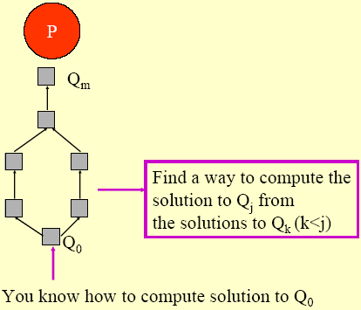
Intuitive Explanation
Given a problem P, obtain a sequence of problems Q₀, Q₁, …., Q_{m}, where:
  You have a solution to Q₀
  The solution to a problem Q_{j}, j > 0, can be obtained from solutions to problems Q₀...Q_{k}, k < j, that appear earlier in the “sequence”.

Slide 12
Elements of Dynamic Programming
DP is used to solve problems with the following characteristics:
  Optimal sub-structure (Principle of Optimality)
    an optimal solution to the problem contains within its optimal solutions to sub-problems.
  Overlapping sub problems
    there exist some places where we solve the same sub problem more than once

Slide 13
Example: Fibonacci Numbers
F(6) = 8
F(5)
F(4)
F(4)
F(3)
F(3)
F(2)
F(3)
F(2)
F(2)
F(1)
F(2)
F(1)
F(1)
F(0)
F(2)
F(1)
F(1)
F(0)
F(1)
F(0)
F(1)
F(0)
F(1)
F(0)
We keep calculating the same value over and over!
  Subproblems are overlapping – they share sub-subproblems

Slide 14
Steps to Designing a
Dynamic Programming Algorithm
Characterize optimal sub-structure
Recursively define the value of an optimal solution
Compute the value bottom up
(if needed) Construct an optimal solution

Slide 15
1.Optimal Sub-Structure
An optimal solution to the problem contains optimal solutions to sub-problems
  Solution to a problem:
    Making a choice out of a number of possibilities (look what possible choices there can be)
    Solving one or more sub-problems that are the result of a choice (characterize the space of sub-problems)
  Show that solutions to sub-problems must themselves be optimal for the whole solution to be optimal.

Slide 16
2. Recursive Solution
Write a recursive solution for the value of an optimal solution.
Show that the number of different instances of sub-problems is bounded by a polynomial.

Slide 17
3. Bottom Up
Compute the value of an optimal solution in a bottom-up fashion, so that you always have the necessary sub-results pre-computed (or use memoization)
Check if it is possible to reduce the space requirements, by “forgetting” solutions to sub-problems that will not be used any more

Slide 18
4. Construct Optimal Solution
Construct an optimal solution from computed information (which records a sequence of choices made that lead to an optimal solution)

Slide 19
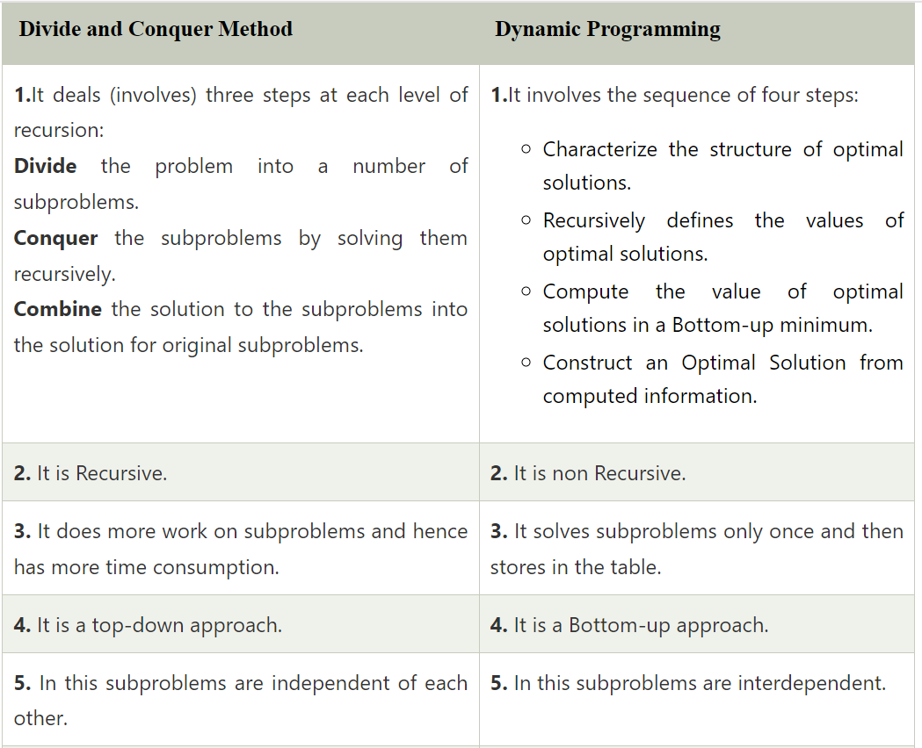

Slide 20
https://testbook.com/key-differences/difference-between-divide-and-conquer-and-dynamic-programming

Slide 21
Knapsack Problem

Slide 22
The Knapsack Problem
The famous knapsack problem:
  A thief breaks into a museum. Fabulous paintings, sculptures, and jewels are everywhere. The thief has a good eye for the value of these objects, and knows that each will fetch hundreds or thousands of dollars on the clandestine art collector’s market. But, the thief has only brought a single knapsack to the scene of the robbery, and can take away only what he can carry. What items should the thief take to maximize the haul?

Slide 23
0-1 Knapsack problem
Given a knapsack with maximum capacity W, and a set S consisting of n items
Each item i has some weight w_{i} and benefit value b_{i} (all w_{i} , b_{i} and W are integer values)
Problem: How to pack the knapsack to achieve maximum total value of packed items?

Slide 24
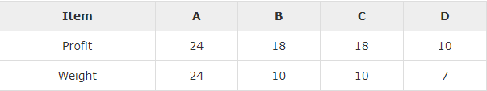
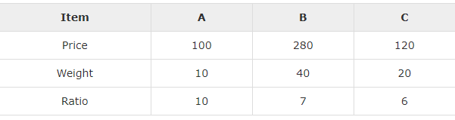
Knapsack Size = 25
Knapsack size = 60

Slide 25
0-1 Knapsack problem: a picture
Weight
Benefit value
w_{i}
b_{i}
Items
3
2
This is a knapsack
Max weight: W = 20
3
4
4
5
5
8
W = 20
9
10

Slide 26
The Knapsack Problem
More formally, the 0-1 knapsack problem:
  The thief must choose among n items, where the ith item worth v_{i} dollars and weighs w_{i} pounds
  Carrying at most W pounds, maximize value
    Note: assume v_{i}, w_{i}, and W are all integers
    “0-1” b/c each item must be taken or left in entirety
A variation, the fractional knapsack problem:
  Thief can take fractions of items
  Think of items in 0-1 problem as gold ingots, in fractional problem as buckets of gold dust

Slide 27
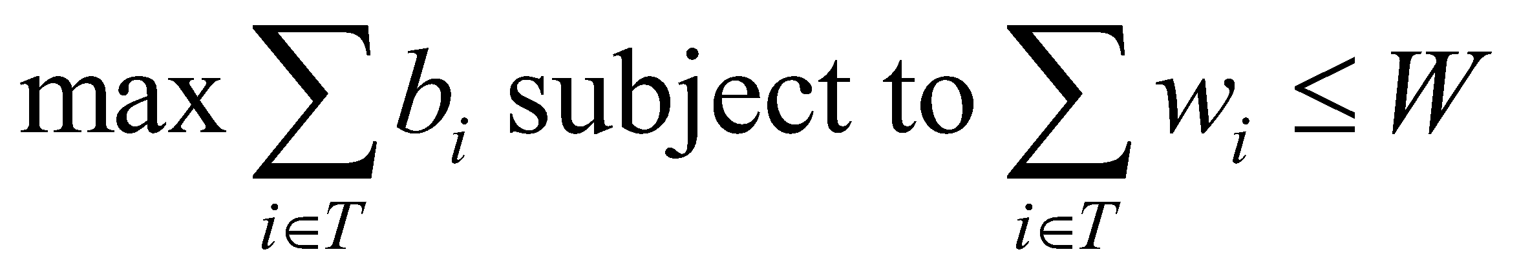
0-1 Knapsack problem
Problem, in other words, is to find
The problem is called a “0-1” problem, because each item must be entirely accepted or rejected.
Just another version of this problem is the “Fractional Knapsack Problem”, where we can take fractions of items.

Slide 28
0-1 Knapsack problem: brute-force approach
Let’s first solve this problem with a straightforward algorithm
Since there are n items, there are 2^{n} possible combinations of items.
We go through all combinations and find the one with the most total value and with total weight less or equal to W
Running time will be O(2^{n})

Slide 29
0-1 Knapsack problem: brute-force approach
Can we do better?
Yes, with an algorithm based on dynamic programming
We need to carefully identify the subproblems
Let’s try this:
If items are labeled 1..n, then a subproblem
would be to find an optimal solution for
S_{k} = {items labeled 1, 2, .. k}

Slide 30
Defining a Subproblem
If items are labeled 1..n, then a subproblem would be to find an optimal solution for S_{k} = {items labeled 1, 2, .. k}
This is a valid subproblem definition.
The question is: can we describe the final solution (S_{n} ) in terms of subproblems (S_{k})?
Unfortunately, we can’t do that. Explanation follows….

Slide 31
Defining a Subproblem
w₁ =2
b₁ =3
w₂ =3
b₂ =4
w₃ =4
b₃ =5
w₄ =5
b₄ =8
Weight
Benefit
Item
#
w_{i}
b_{i}
?
1
2
3
Max weight: W = 20
For S₄:
Total weight: 14;
total benefit: 20
S₄
2
3
4
S₅
3
4
5
4
5
8
5
9
10
w₁ =2
b₁ =3
w₃ =4
b₃=5
w₄ =5
b₄ =8
w₅ =9
b₅ =10
Solution for S₄ is not part of the solution for S₅!!!
For S₅:
Total weight: 20
total benefit: 26

Slide 32
Defining a Subproblem (continued)
As we have seen, the solution for S₄ is not part of the solution for S₅
So, our definition of a subproblem is flawed and we need another one!
Let’s add another parameter: w, which will represent the exact weight for each subset of items
The subproblem then will be to compute B[k,w]

Slide 33
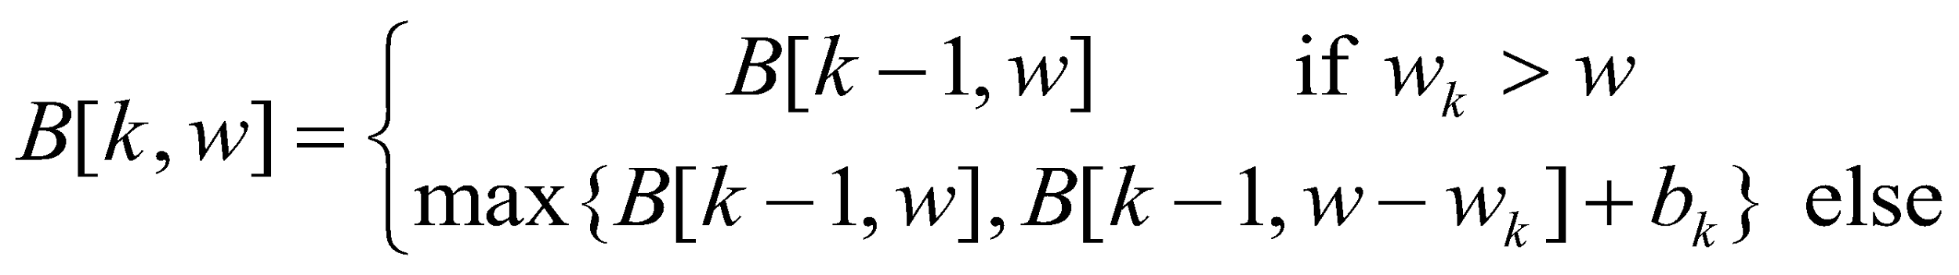
Recursive Formula for subproblems
Recursive formula for subproblems:
It means, that the best subset of S_{k} that has total weight w is one of the two:
1) the best subset of S_{k-1} that has total weight w, or
2) the best subset of S_{k-1} that has total weight w-w_{k} plus the item k

Slide 34
Recursive Formula
The best subset of S_{k} that has the total weight w, either contains item k or not.
First case: w_{k}>w. Item k can’t be part of the solution, since if it was, the total weight would be > w, which is unacceptable
Second case: w_{k} <=w. Then the item k can be in the solution, and we choose the case with greater value

Slide 35
The Knapsack Problem And Optimal Substructure
Both variations exhibit optimal substructure
To show this for the 0-1 problem, consider the most valuable load weighing at most W pounds
  If we remove item j from the load, what do we know about the remaining load?
  A: remainder must be the most valuable load weighing at most W - w_{j} that thief could take from museum, excluding item j

Slide 36
Solving The Knapsack Problem
The optimal solution to the fractional knapsack problem can be found with a greedy algorithm
  How?
The optimal solution to the 0-1 problem cannot be found with the same greedy strategy
  Greedy strategy: take in order of dollars/pound
  Example: 3 items weighing 10, 20, and 30 pounds, knapsack can hold 50 pounds
    Suppose item 2 is worth $100. Assign values to the other items so that the greedy strategy will fail

Slide 37
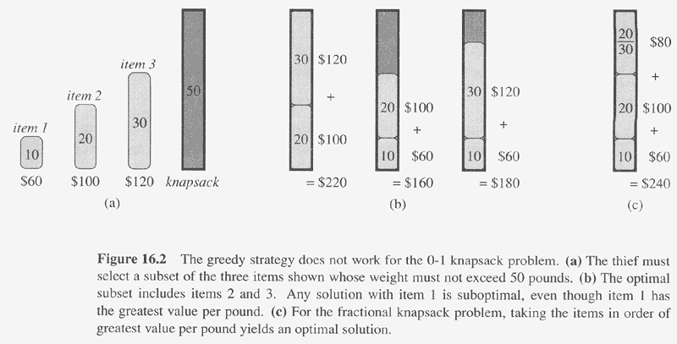
Copyright © The McGraw-Hill Companies, Inc. Permission required for reproduction or display.

Slide 38
The Knapsack Problem: Greedy Vs. Dynamic
The fractional problem can be solved greedily
The 0-1 problem cannot be solved with a greedy approach
  As you have seen, however, it can be solved with dynamic programming

Slide 39
Fractional-knapsack
Greedy-fractional-knapsack (w, v, W)
FOR i =1 to n
do x[i] =0
weight = 0
while weight < W
do i = best remaining item
IF weight + w[i] ≤ W
then x[i] = 1
weight = weight + w[i]
else
x[i] = (w - weight) / w[i]
weight = W
return x

Slide 40
0-1 Knapsack Algorithm
for w = 0 to W
B[0,w] = 0
for i = 0 to n
B[i,0] = 0
for w = 0 to W
if wi <= w // item i can be part of the solution
if bi + B[i-1,w-wi] > B[i-1,w]
B[i,w] = bi + B[i-1,w- wi]
else
B[i,w] = B[i-1,w]
else B[i,w] = B[i-1,w] // wi > w

Slide 41
Running time
O(W)
for w = 0 to W
B[0,w] = 0
for i = 0 to n
B[i,0] = 0
for w = 0 to W
< the rest of the code >
Repeat n times
O(W)
What is the running time of this algorithm?
O(n*W)
Remember that the brute-force algorithm takes O(2^{n})

Slide 42
Example
Let’s run our algorithm on the
following data:
n = 4 (# of elements)
W = 5 (max weight)
Elements (weight, benefit):
(2,3), (3,4), (4,5), (5,6)

Slide 43
Example (2)
i
0
1
2
3
4
W
0
0
1
0
2
0
3
0
4
0
5
0
for w = 0 to W
B[0,w] = 0

Slide 44
Example (3)
i
0
1
2
3
4
W
0
0
0
0
0
0
1
0
2
0
3
0
4
0
5
0
for i = 0 to n
B[i,0] = 0

Slide 45
Example (4)
Items:
1: (2,3)
2: (3,4)
3: (4,5)
4: (5,6)
i
0
1
2
3
4
W
0
0
0
0
0
0
i=1
b_{i}=3
w_{i}=2
w=1
w-w_{i} =-1
1
0
0
2
0
3
0
4
0
5
0
if w_{i} <= w // item i can be part of the solution
if b_{i} + B[i-1,w-w_{i}] > B[i-1,w]
B[i,w] = b_{i} + B[i-1,w- w_{i}]
else
B[i,w] = B[i-1,w]
else B[i,w] = B[i-1,w] // w_{i} > w

Slide 46
Example (5)
Items:
1: (2,3)
2: (3,4)
3: (4,5)
4: (5,6)
i
0
1
2
3
4
W
0
0
0
0
0
0
i=1
b_{i}=3
w_{i}=2
w=2
w-w_{i} =0
1
0
0
2
0
3
3
0
4
0
5
0
if w_{i} <= w // item i can be part of the solution
if b_{i} + B[i-1,w-w_{i}] > B[i-1,w]
B[i,w] = b_{i} + B[i-1,w- w_{i}]
else
B[i,w] = B[i-1,w]
else B[i,w] = B[i-1,w] // w_{i} > w

Slide 47
Example (6)
Items:
1: (2,3)
2: (3,4)
3: (4,5)
4: (5,6)
i
0
1
2
3
4
W
0
0
0
0
0
0
i=1
b_{i}=3
w_{i}=2
w=3
w-w_{i}=1
1
0
0
2
0
3
3
0
3
4
0
5
0
if w_{i} <= w // item i can be part of the solution
if b_{i} + B[i-1,w-w_{i}] > B[i-1,w]
B[i,w] = b_{i} + B[i-1,w- w_{i}]
else
B[i,w] = B[i-1,w]
else B[i,w] = B[i-1,w] // w_{i} > w

Slide 48
Example (7)
Items:
1: (2,3)
2: (3,4)
3: (4,5)
4: (5,6)
i
0
1
2
3
4
W
0
0
0
0
0
0
i=1
b_{i}=3
w_{i}=2
w=4
w-w_{i}=2
1
0
0
2
0
3
3
0
3
4
0
3
5
0
if w_{i} <= w // item i can be part of the solution
if b_{i} + B[i-1,w-w_{i}] > B[i-1,w]
B[i,w] = b_{i} + B[i-1,w- w_{i}]
else
B[i,w] = B[i-1,w]
else B[i,w] = B[i-1,w] // w_{i} > w

Slide 49
Example (8)
Items:
1: (2,3)
2: (3,4)
3: (4,5)
4: (5,6)
i
0
1
2
3
4
W
0
0
0
0
0
0
i=1
b_{i}=3
w_{i}=2
w=5
w-w_{i}=2
1
0
0
2
0
3
3
0
3
4
0
3
5
0
3
if w_{i} <= w // item i can be part of the solution
if b_{i} + B[i-1,w-w_{i}] > B[i-1,w]
B[i,w] = b_{i} + B[i-1,w- w_{i}]
else
B[i,w] = B[i-1,w]
else B[i,w] = B[i-1,w] // w_{i} > w

Slide 50
Example (9)
Items:
1: (2,3)
2: (3,4)
3: (4,5)
4: (5,6)
i
0
1
2
3
4
W
0
0
0
0
0
0
i=2
b_{i}=4
w_{i}=3
w=1
w-w_{i}=-2
1
0
0
0
2
0
3
3
0
3
4
0
3
5
0
3
if w_{i} <= w // item i can be part of the solution
if b_{i} + B[i-1,w-w_{i}] > B[i-1,w]
B[i,w] = b_{i} + B[i-1,w- w_{i}]
else
B[i,w] = B[i-1,w]
else B[i,w] = B[i-1,w] // w_{i} > w

Slide 51
Example (10)
Items:
1: (2,3)
2: (3,4)
3: (4,5)
4: (5,6)
i
0
1
2
3
4
W
0
0
0
0
0
0
i=2
b_{i}=4
w_{i}=3
w=2
w-w_{i}=-1
1
0
0
0
2
0
3
3
3
0
3
4
0
3
5
0
3
if w_{i} <= w // item i can be part of the solution
if b_{i} + B[i-1,w-w_{i}] > B[i-1,w]
B[i,w] = b_{i} + B[i-1,w- w_{i}]
else
B[i,w] = B[i-1,w]
else B[i,w] = B[i-1,w] // w_{i} > w

Slide 52
Example (11)
Items:
1: (2,3)
2: (3,4)
3: (4,5)
4: (5,6)
i
0
1
2
3
4
W
0
0
0
0
0
0
i=2
b_{i}=4
w_{i}=3
w=3
w-w_{i}=0
1
0
0
0
2
0
3
3
3
0
3
4
4
0
3
5
0
3
if w_{i} <= w // item i can be part of the solution
if b_{i} + B[i-1,w-w_{i}] > B[i-1,w]
B[i,w] = b_{i} + B[i-1,w- w_{i}]
else
B[i,w] = B[i-1,w]
else B[i,w] = B[i-1,w] // w_{i} > w

Slide 53
Example (12)
Items:
1: (2,3)
2: (3,4)
3: (4,5)
4: (5,6)
i
0
1
2
3
4
W
0
0
0
0
0
0
i=2
b_{i}=4
w_{i}=3
w=4
w-w_{i}=1
1
0
0
0
2
0
3
3
3
0
3
4
4
0
3
4
5
0
3
if w_{i} <= w // item i can be part of the solution
if b_{i} + B[i-1,w-w_{i}] > B[i-1,w]
B[i,w] = b_{i} + B[i-1,w- w_{i}]
else
B[i,w] = B[i-1,w]
else B[i,w] = B[i-1,w] // w_{i} > w

Slide 54
Example (13)
Items:
1: (2,3)
2: (3,4)
3: (4,5)
4: (5,6)
i
0
1
2
3
4
W
0
0
0
0
0
0
i=2
b_{i}=4
w_{i}=3
w=5
w-w_{i}=2
1
0
0
0
2
0
3
3
3
0
3
4
4
0
3
4
5
0
3
7
if w_{i} <= w // item i can be part of the solution
if b_{i} + B[i-1,w-w_{i}] > B[i-1,w]
B[i,w] = b_{i} + B[i-1,w- w_{i}]
else
B[i,w] = B[i-1,w]
else B[i,w] = B[i-1,w] // w_{i} > w

Slide 55
Example (14)
Items:
1: (2,3)
2: (3,4)
3: (4,5)
4: (5,6)
i
0
1
2
3
4
W
0
0
0
0
0
0
i=3
b_{i}=5
w_{i}=4
w=1..3
1
0
0
0
0
0
2
0
3
3
3
3
0
3
4
4
4
0
3
4
5
0
3
7
if w_{i} <= w // item i can be part of the solution
if b_{i} + B[i-1,w-w_{i}] > B[i-1,w]
B[i,w] = b_{i} + B[i-1,w- w_{i}]
else
B[i,w] = B[i-1,w]
else B[i,w] = B[i-1,w] // w_{i} > w

Slide 56
Example (15)
Items:
1: (2,3)
2: (3,4)
3: (4,5)
4: (5,6)
i
0
1
2
3
4
W
0
0
0
0
0
0
i=3
b_{i}=5
w_{i}=4
w=4
w- w_{i}=0
1
0
0
0
0
0
2
0
3
3
3
3
0
3
4
4
4
0
3
4
5
5
0
3
7
if w_{i} <= w // item i can be part of the solution
if b_{i} + B[i-1,w-w_{i}] > B[i-1,w]
B[i,w] = b_{i} + B[i-1,w- w_{i}]
else
B[i,w] = B[i-1,w]
else B[i,w] = B[i-1,w] // w_{i} > w

Slide 57
Example (15)
Items:
1: (2,3)
2: (3,4)
3: (4,5)
4: (5,6)
i
0
1
2
3
4
W
0
0
0
0
0
0
i=3
b_{i}=5
w_{i}=4
w=5
w- w_{i}=1
1
0
0
0
0
0
2
0
3
3
3
3
0
3
4
4
4
0
3
4
5
5
0
3
7
7
if w_{i} <= w // item i can be part of the solution
if b_{i} + B[i-1,w-w_{i}] > B[i-1,w]
B[i,w] = b_{i} + B[i-1,w- w_{i}]
else
B[i,w] = B[i-1,w]
else B[i,w] = B[i-1,w] // w_{i} > w

Slide 58
Example (16)
Items:
1: (2,3)
2: (3,4)
3: (4,5)
4: (5,6)
i
0
1
2
3
4
W
0
0
0
0
0
0
i=3
b_{i}=5
w_{i}=4
w=1..4
1
0
0
0
0
0
0
2
0
3
3
3
3
3
0
3
4
4
4
4
0
3
4
5
5
5
0
3
7
7
if w_{i} <= w // item i can be part of the solution
if b_{i} + B[i-1,w-w_{i}] > B[i-1,w]
B[i,w] = b_{i} + B[i-1,w- w_{i}]
else
B[i,w] = B[i-1,w]
else B[i,w] = B[i-1,w] // w_{i} > w

Slide 59
Example (17)
Items:
1: (2,3)
2: (3,4)
3: (4,5)
4: (5,6)
i
0
1
2
3
4
W
0
0
0
0
0
0
i=3
b_{i}=5
w_{i}=4
w=5
1
0
0
0
0
0
0
2
0
3
3
3
3
3
0
3
4
4
4
4
0
3
4
5
5
5
0
3
7
7
7
if w_{i} <= w // item i can be part of the solution
if b_{i} + B[i-1,w-w_{i}] > B[i-1,w]
B[i,w] = b_{i} + B[i-1,w- w_{i}]
else
B[i,w] = B[i-1,w]
else B[i,w] = B[i-1,w] // w_{i} > w

Slide 60
Comments
This algorithm only finds the max possible value that can be carried in the knapsack
To know the items that make this maximum value, an addition to this algorithm is necessary
Please see LCS algorithm lecture for the example how to extract this data from the table we built

Slide 61
Books
Introduction to Algorithms, Third Edition, Thomas H. Cormen, Charle E. Leiserson, Ronald L. Rivest, Clifford Stein (CLRS).
Fundamental of Computer Algorithms, Ellis Horowitz, Sartaj Sahni, Sanguthevar Rajasekaran (HSR)

Slide 62
References
https://algorithmist.com/wiki/Dynamic_programming
https://www.topcoder.com/community/competitive-programming/tutorials/dynamic-programming-from-novice-to-advanced/
CLRS: 15.3
HSR: 5.1, 5.5

